Slide 1
PREDICTION OF DOWNHOLE PRESSURE USING MACHINE LEARNING MODELS
SUPARNA BHATTACHARJEE, SRUTHI KARICHERI, JENNIE RAN
FINAL PROJECT, Data Analytics Boot Camp RICE University

Slide 2

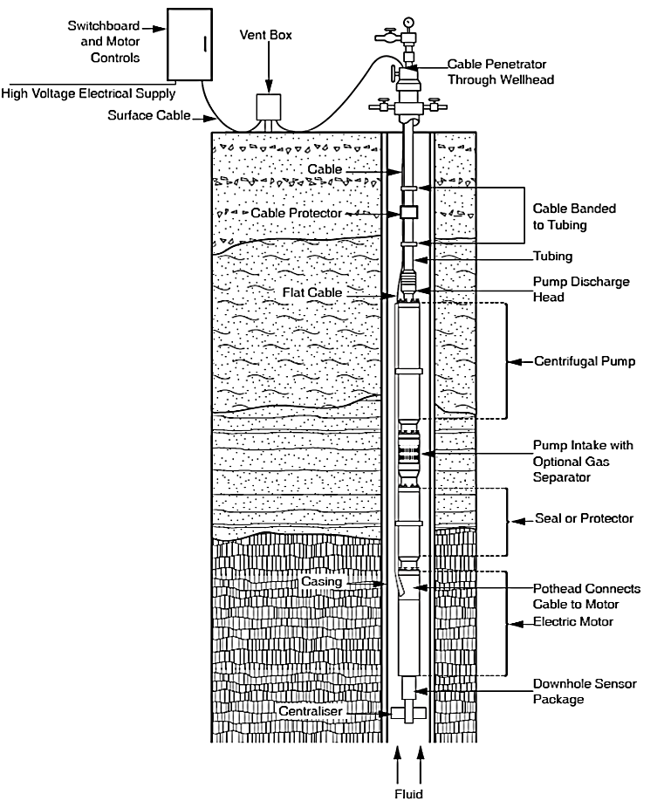
OBJECTIVE
Well Head Measurements
(Input Variables)
Predict downhole pressure from wellhead data for the feasibilities of :
Well completion without downhole gauges.
Reduction of the completion cost.
Avoiding shutdown time for gauge/sensor maintenance.
Average Downhole
Pressure
(Target Variable)

Slide 3
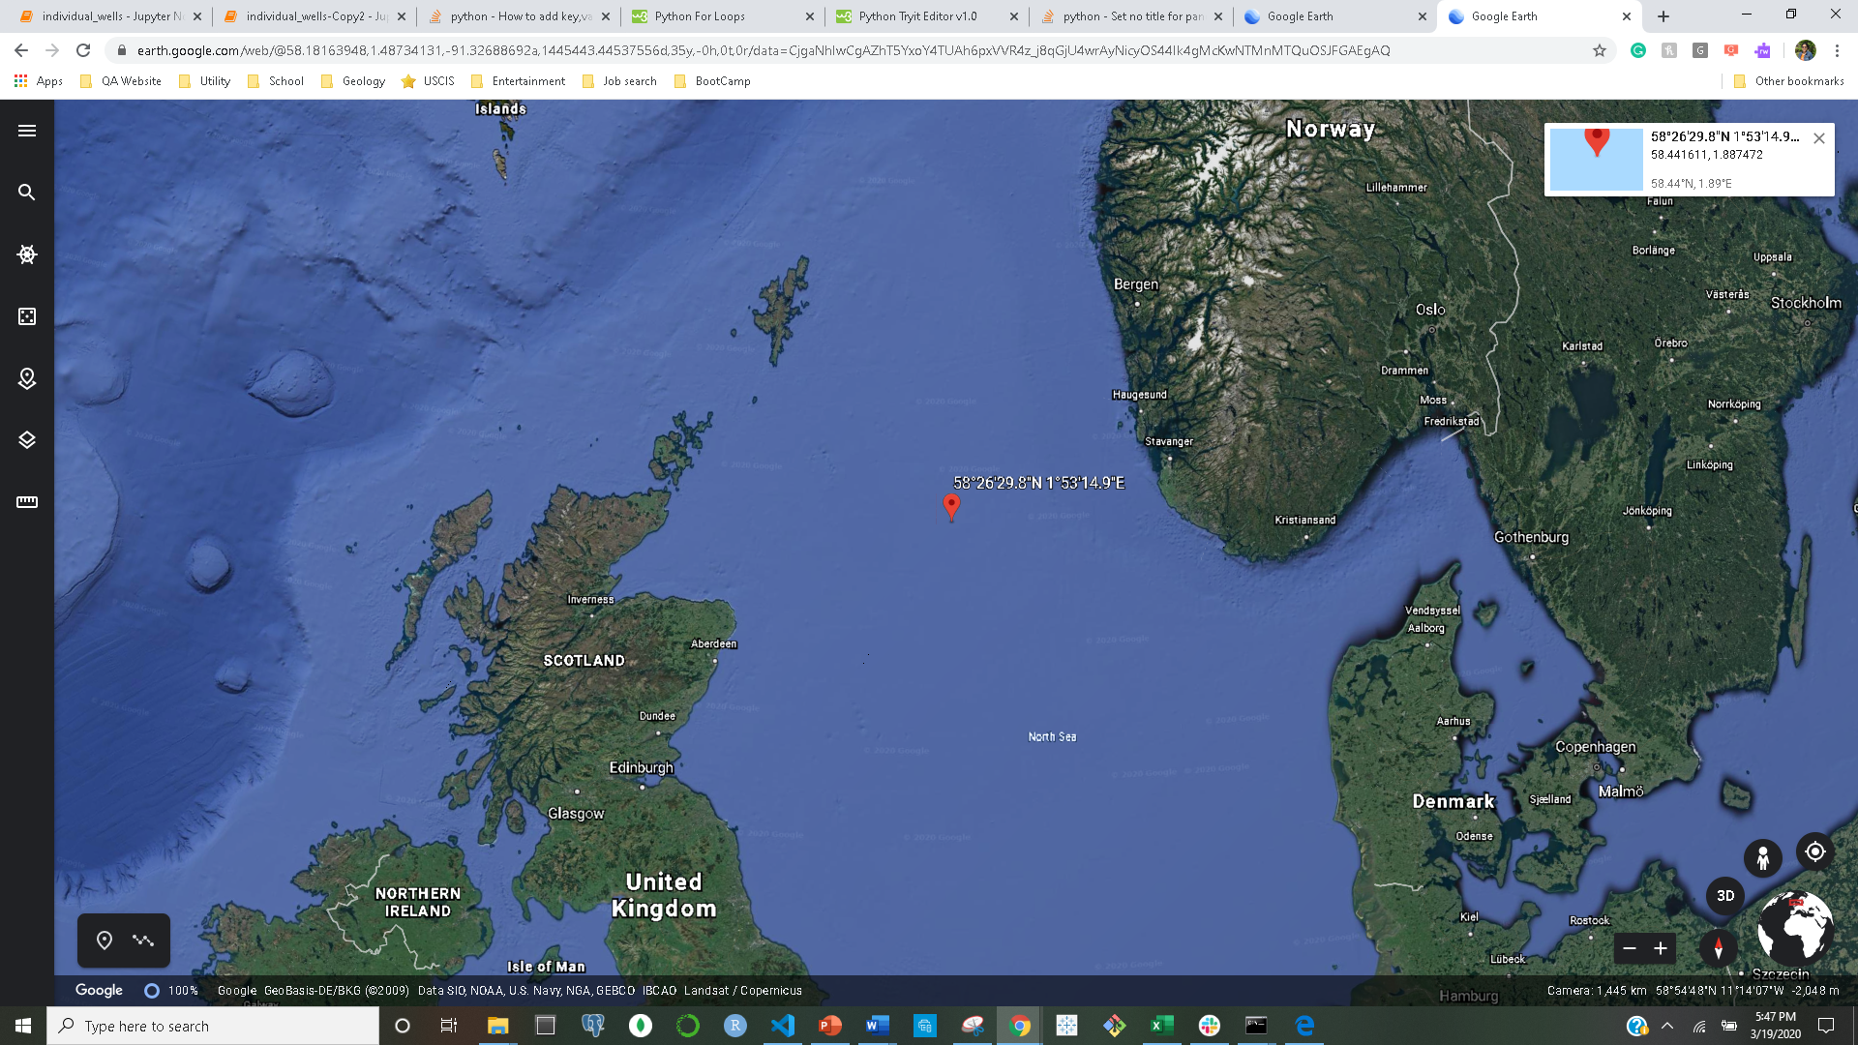
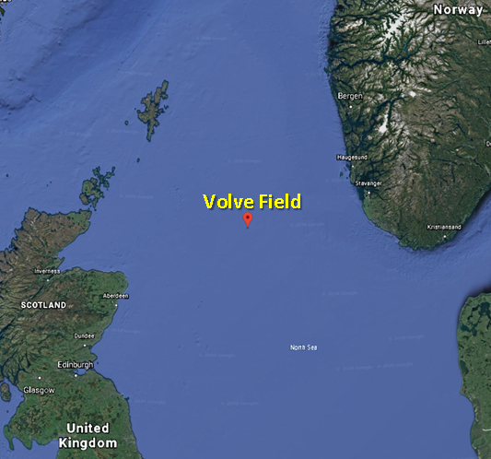
DATA SOURCE
Production data from the Volve Field, North Sea.
Released by Equinor in 2018.
Structured data from five production wells.
Duration 2008 to 2016.
Set of 24 categorical and numerical data from both wellhead and downhole measurements.
Volve Field

Slide 4
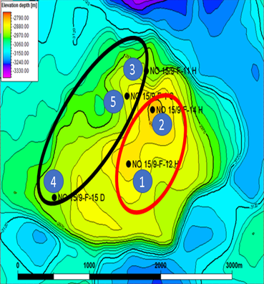
DATA INTRODUCTION
Two discovery wells are on the crest of the structure.
Production since 2008
Highly deviated to horizontal wells
Three appraisal wells are on the flank.
Production since 2013-14
Highly deviated to horizontal wells

Slide 5
FEATURE AND TARGET VARIABLES
Surface Measurements
(Input Variable)
Derived and unrelated numerical variables avoided.
DP Tubing
DP Choke Size
Annulus Pressure
All categorical variables were also avoided.
Well Name
Well Type
Facility Code
Choke Size
Wellhead Pressure
Wellhead Temperature
Oil Volume
Gas Volume
Water Volume
Average Downhole
Pressure
(Target Variable)

Slide 6
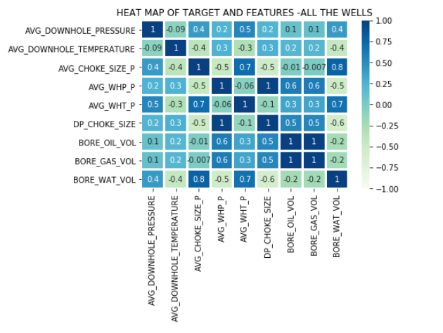
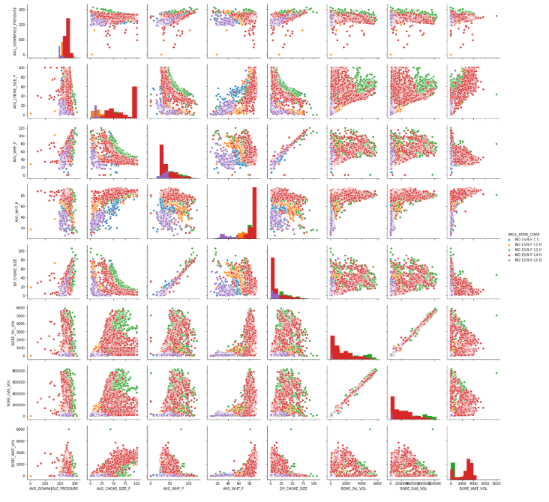
EXPLORATORY DATA ANALYSIS
Relationship between the features and target variable.
Scatter plots
Little or no Multicollinearity between the features.
Heat Map
Pairwise plotting

Slide 7
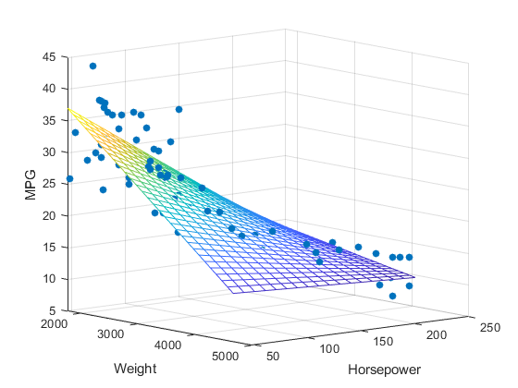
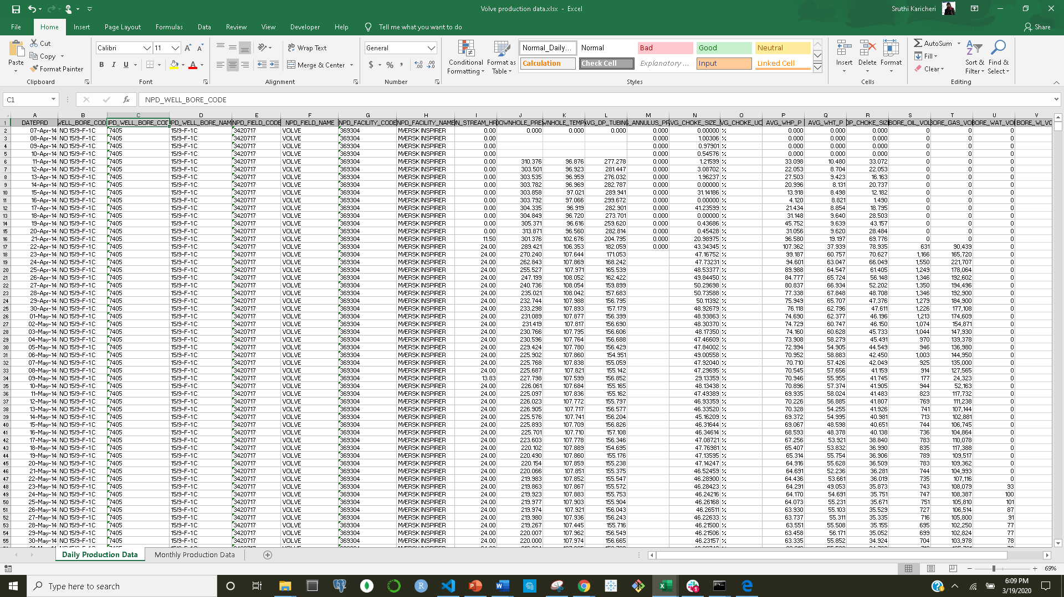
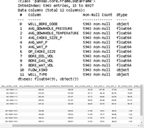
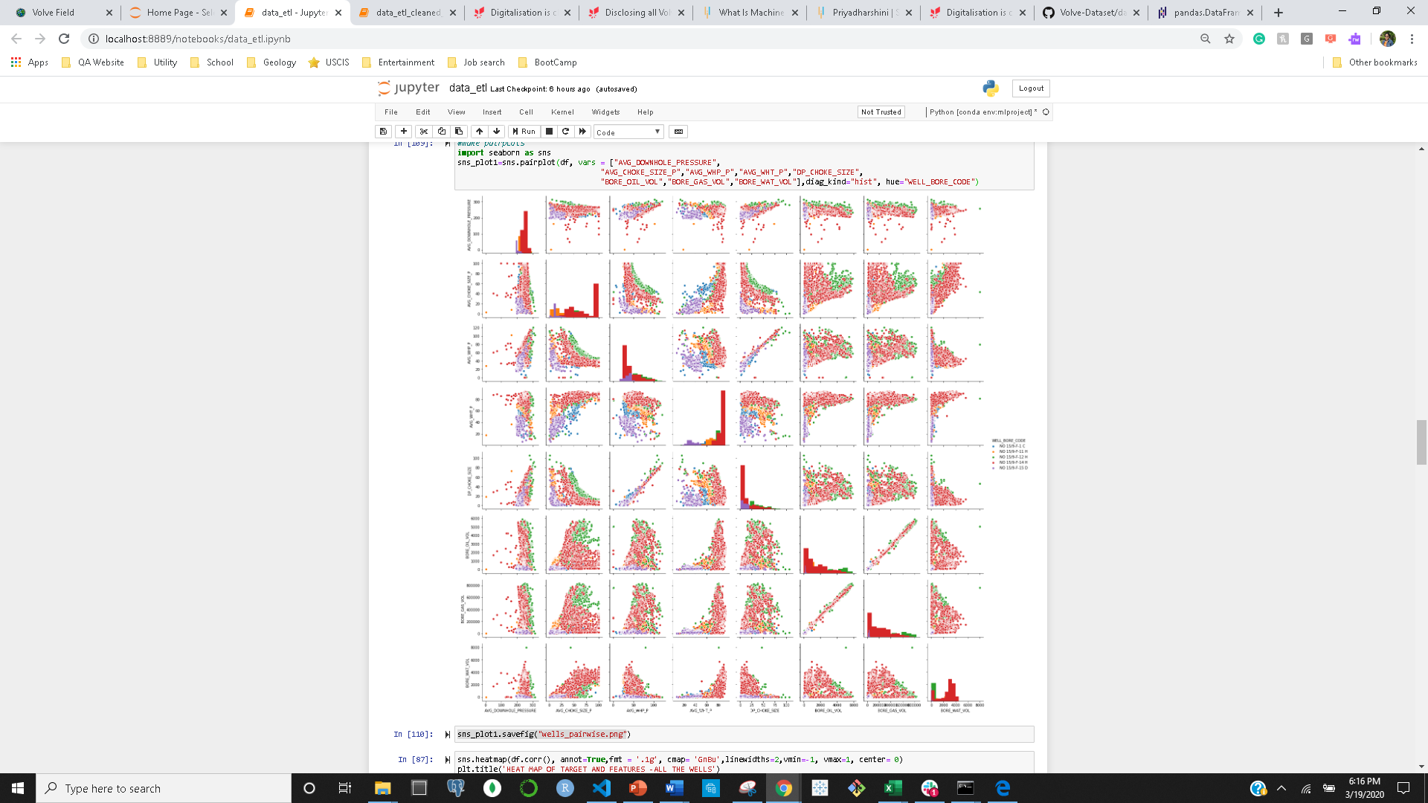


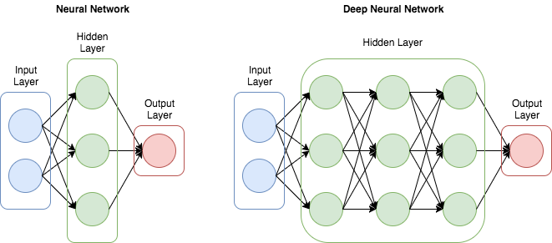
PROJECT WORKFLOW
Multi-Linear
model
Random Forrest
model
Raw Data File
Data Cleaning and Wrangling
EDA
Neural Network
model
ML

Slide 8
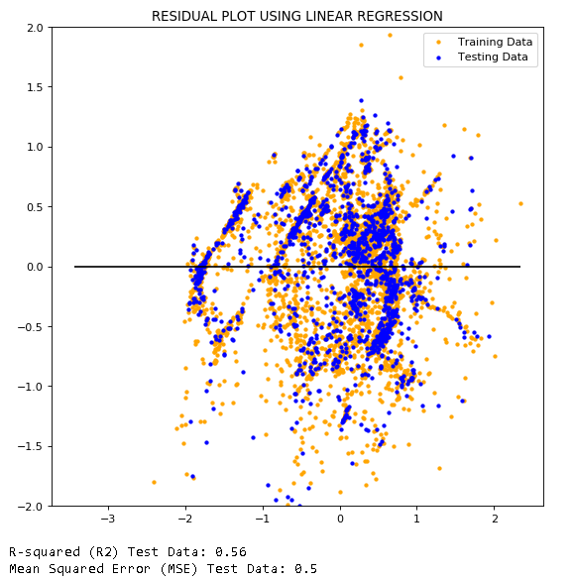
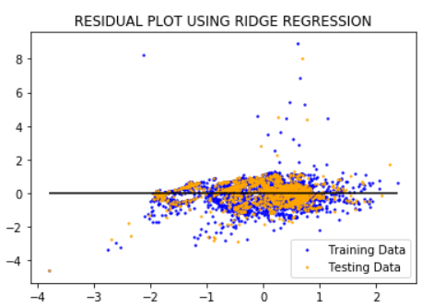
LINEAR AND RIDGE REGRESSION

Slide 9
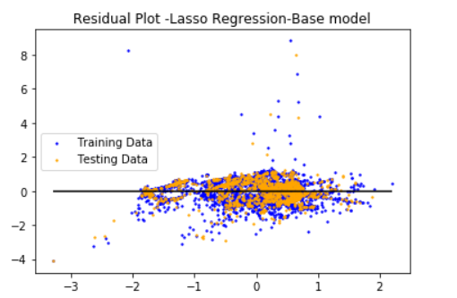
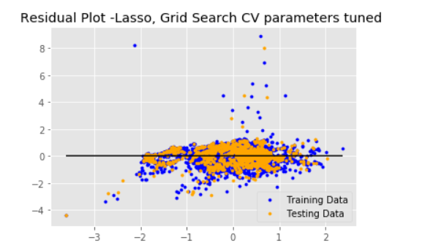
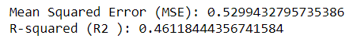
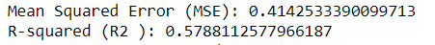
LASSO REGRESSION

Slide 10
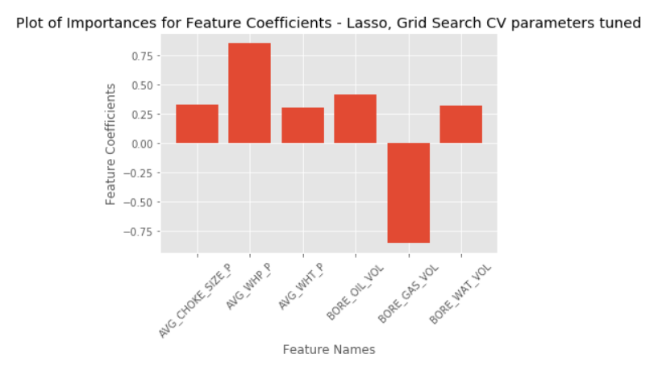
LASSO REGRESSION – GRID SEARCH CV

Slide 11
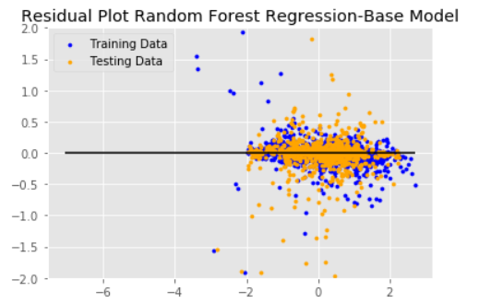
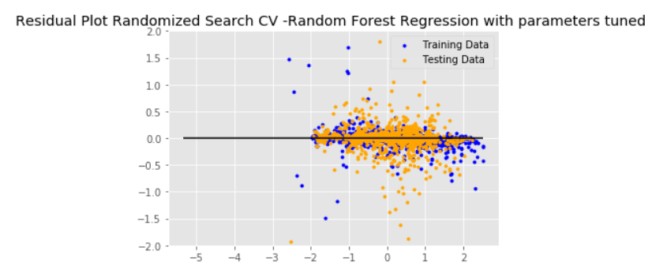
{
RANDOM FOREST REGRESSION
Notes:
Parameters tuned:
{'n_estimators': 522, 'min_samples_split': 2, 'min_samples_leaf': 2, 'max_features': 'sqrt', 'max_depth': 110, 'bootstrap': False}
N-estimators : The number of trees in the forest.
max_depthinteger or None, optional (default=None)The maximum depth of the tree. If None, then nodes are expanded until all leaves are pure or until all leaves contain less than min_samples_split samples.
min_samples_splitint, float, optional (default=2)The minimum number of samples required to split an internal node:
If int, then consider min_samples_split as the minimum number.
If float, then min_samples_split is a fraction and ceil(min_samples_split * n_samples) are the minimum number of samples for each split.
Changed in version 0.18: Added float values for fractions.
min_samples_leafint, float, optional (default=1)The minimum number of samples required to be at a leaf node. A split point at any depth will only be considered if it leaves at least min_samples_leaf training samples in each of the left and right branches. This may have the effect of smoothing the model, especially in regression.
max_featuresint, float, string or None, optional (default=”auto”)The number of features to consider when looking for the best split:
If int, then consider max_features features at each split.
If float, then max_features is a fraction and int(max_features * n_features) features are considered at each split.
If “auto”, then max_features=n_features.
If “sqrt”, then max_features=sqrt(n_features).
If “log2”, then max_features=log2(n_features).
If None, then max_features=n_features.
bootstrapboolean, optional (default=True)Whether bootstrap samples are used when building trees. If False, the whole datset is used to build each tree.

Slide 12
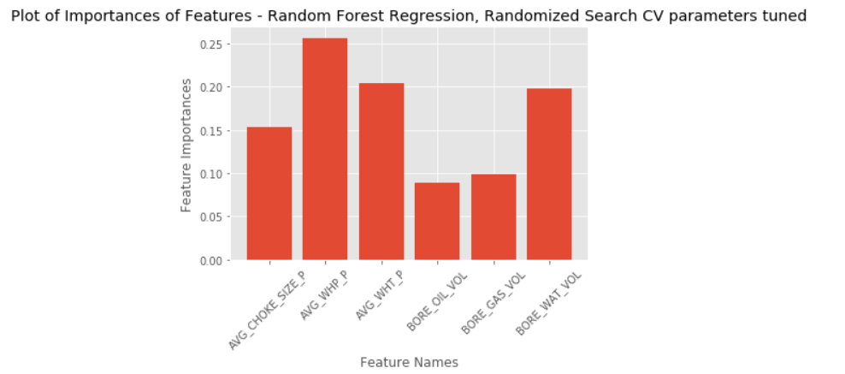
RANDOM FOREST REGRESSION – RANDOMIZED SEARCH CV

Slide 13
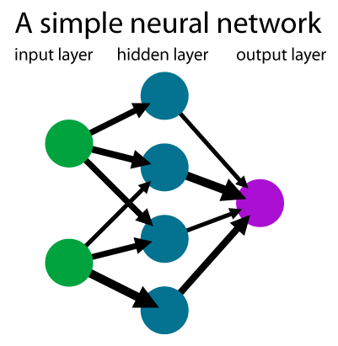
Neural Network
Keras Sequential Model
Basic model -> Overfitting
Tuning with Hyperas
Best model with hyper parameter optimization

Slide 14
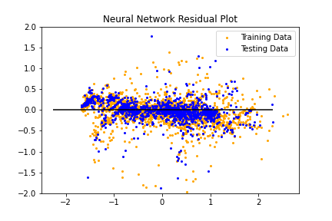
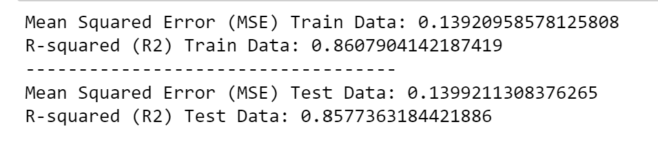
NEURAL NETWORK

Slide 15
ML RESULT SUMMARY
Model Scores
Model | MSE | R Squared
Multi-linear Regression Lasso shrinkage Lasso shrinkage (Tuned) | 0.50 0.52 0.41 | 0.56 0.46 0.58
Random Forest Random Forest (Tuned) | 0.17 0.12 | 0.82 0.87
Neural Network Neural Network (Tuned) | 0.14 0.17 | 0.86 0.89

Slide 16
SUMMARY & CONCLUSIONS
Production data from the Volve Field was properly conditioned and used in the different Machine Leaning models to predict downhole pressure from wellhead variables.
Neural Network method provided the best predictability followed by Random Forrest Method.
Multilinear regression method with low correlation coefficient provided no conclusive outcome.
The study demonstrates that prediction of downhole pressure from wellhead variables using ‘Tuned Neural Network (ML)’ can replace downhole pressure gauges in the Volve Field and it could be potentially extended to other oil producing wells in the world.

